Slide 1
AIML CA2:
Time Series/
Unsupervised Learning
Muhammad Fitri Amir bin Abdullah
DAAA/FT/2A/06
2222811

Slide 2
Steps for both tasks:
Exploratory Data Analysis | Find out more about the dataset
Visualisation | Show the variance of the data, count etc
Data Preprocessing | Scaling the data, encoding etc
Baseline Model | Using a dummy classifier/regressor
Model Selection | Picking which model is the best to use in the task
Model Improvement | Improving the results obtained by chosen model

Slide 3
Table of contents
01
02
Time Series
Unsupervised Learning/ Clustering
In this task, I aim to perform Time Series Forecasting on the Energy Consumption Dataset provided on energy such as gas, water and electricity.
In this task, I aim to cluster customers of a shopping mall to understand customers better in order to retain said customers.

Slide 4
01
Energy Time Series

Slide 5
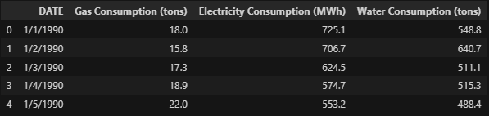
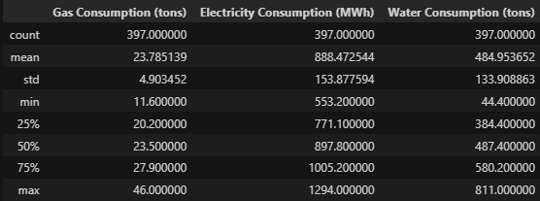
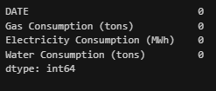
Exploratory Data Analysis
-From the outputs, we can see that there are no categorical features and there is a column with the date, which will be used as our index
-The other features apart from date are all numerical.
-There are a total of 397 data points and 4 columns which all have 0 null values

Slide 6
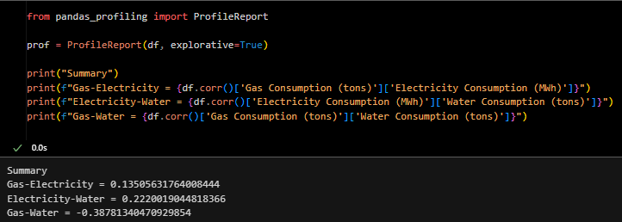
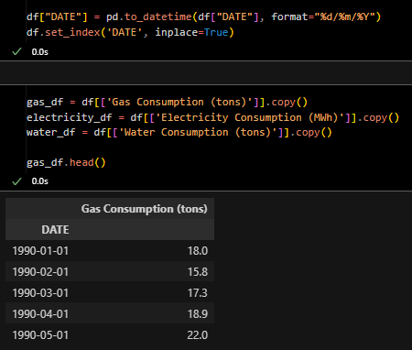
Exploratory Data Analysis
- I used a special pandas tool, pandas-profiling, in order to see if there’s any correlation between any of the columns.
- Before visualising, I made date the index so that it is easier to use when plotting and training the model.

Slide 7
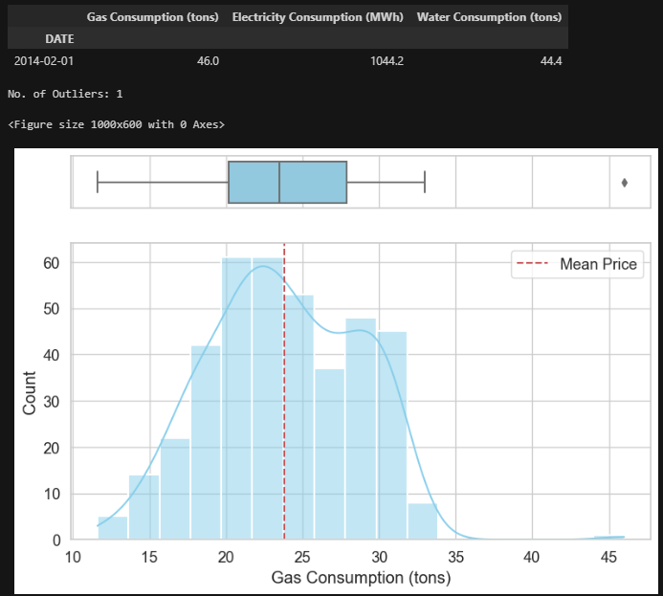
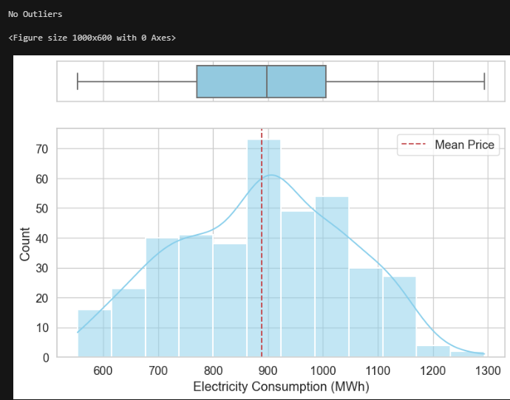
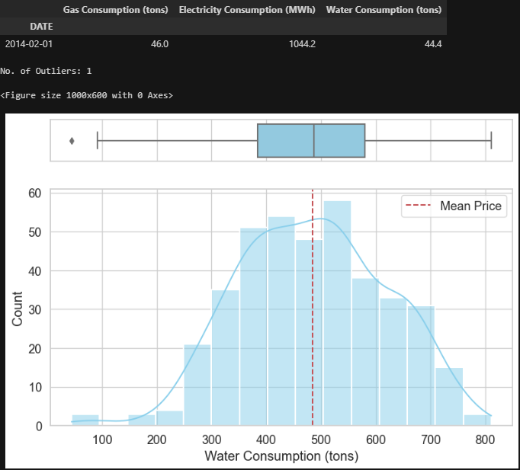
Visualisation
Looking at the distribution of the plots, all 3 are very close to normal distributions. Gas and water both have 1 outlier each, which I did not choose to drop. Gas is slightly positively skewed and water may be bimodal.

Slide 8
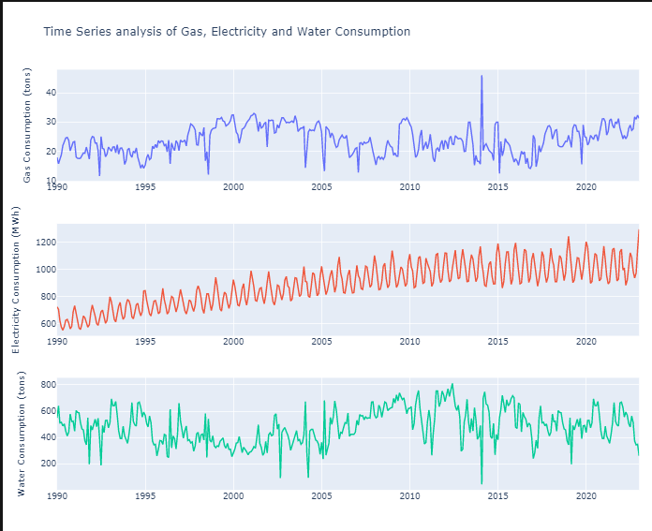
Visualisation
Next, I broke down the time series. As we can see, there are no patterns in water and gas, but there may be one in electricity as there is a pattern of spiking and falling. This shows that there may be a predetermined pattern.

Slide 9
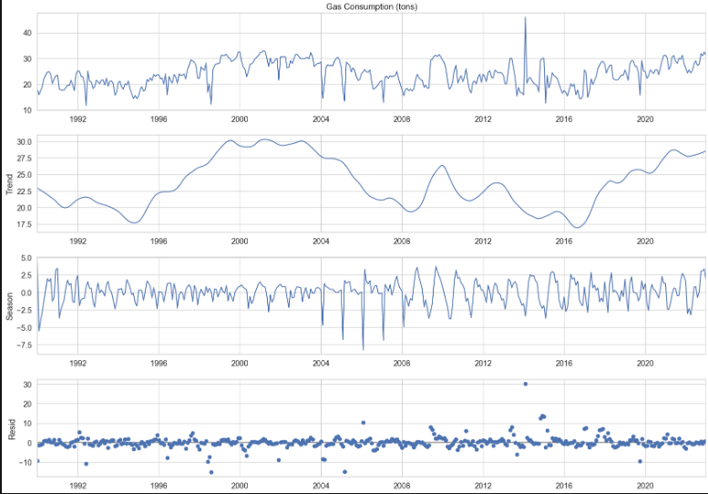
Visualisation
Using the STL function, I was able to find the Seasonality and trends that may be available in the different energies. Firstly, in gas, the trend is quite random, but it appears that there may be some seasonality in the data. The residuals are quite evenly spread around 0 apart from some outliers, specifically between 2012 and 2016. From the residuals to the trend, they display quite constant results and patterns.

Slide 10
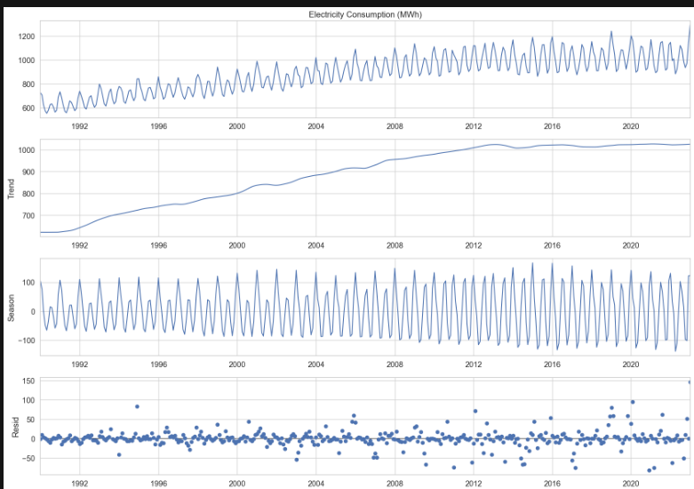
Visualisation
Next, looking at energy, there is an upward trend from 1992 onwards.
Looking at the seasonality, the amplitudes are getting slightly higher year by year, but the pattern is consistent.
In terms of residuals, they are all around 0, similar to gas.
However, as there is a very noticeable trend, we will likely need to difference it before or while performing time series analysis on this column.

Slide 11
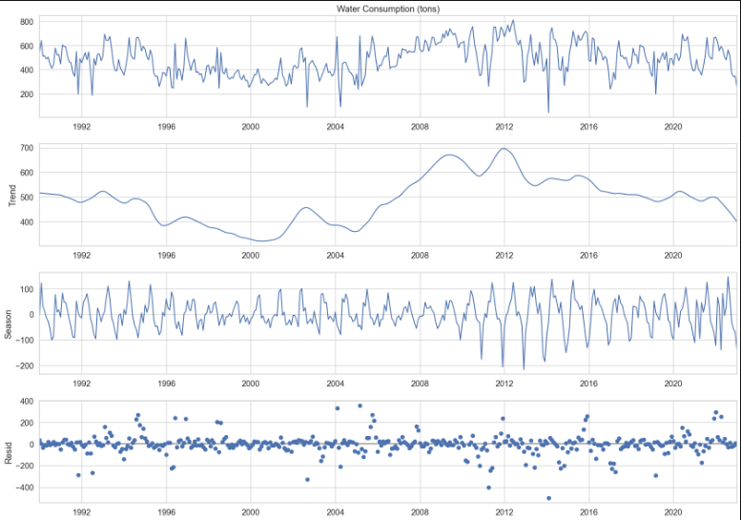
Visualisation
Lastly, looking at water consumption, there appears to be some sort of yearly seasonality. Not only are the patterns very repetitive, but the values over some of the years are very close as well.
This heavily indicates that this column will need differencing, even though the trend is not very clear.
In terms of the residuals, compared to the previous columns, there are a lot more points that are further than the 0 mark, which further indicates the need for differencing.

Slide 12
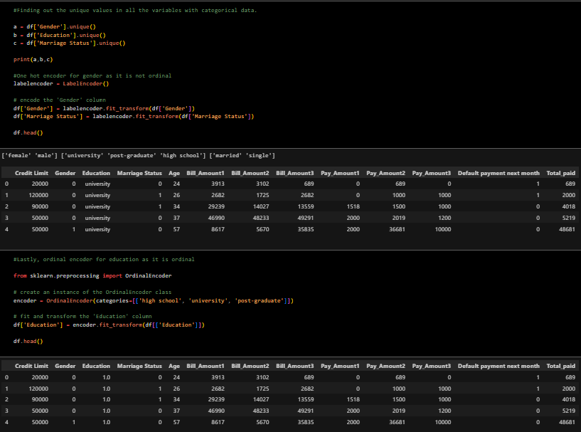
Feature Engineering/Data Preprocessing
Next, in my feature engineering, I label encoded marriage status and gender as they have no order, while ordinal encoding education as there is a hierarchy to education level.
I also fixed the typo of university in the dataset so that I do not mess up the spelling in later codes.

Slide 13
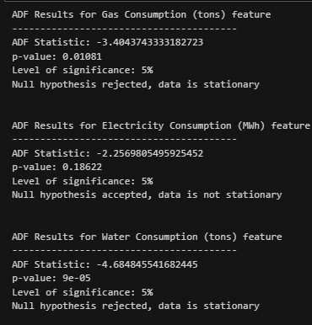
Stationarity tests
Firstly, I did the Augmented Dickey Fuller test, which checks for stationarity through p values.
The null hypothesis is that the data is not stationary, when p>0.05. The alternate hypothesis is that the data is stationary, when p<0.05.
As we can see, only electricity accepts the null hypothesis and requires differencing.
However, I will also use another test to confirm that whether is true.

Slide 14
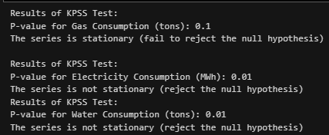
Stationarity tests
Next, I did the Kwiatkowski-Phillips-Schmidt-Shin (KPSS) test. As we can see, electricity is still not stationary and gas is still stationary. However, water is now not stationary. This makes it an ambiguous column as it has returned both stationary and non stationary in different tests. I also did a granger causality test which I feel is not too important to include as the results did not affect my analysis. I also tested the differenced version of water.

Slide 15
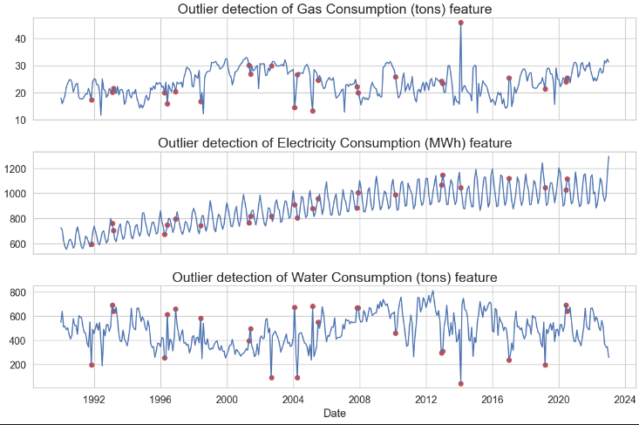
Outlier detection
I used moving averages to find out if there were any outliers. I feel that you cannot use normal methods of outlier detection as it is not the right context.
Moving averages provide a smoothed representation of the data, which can make it easier to detect gradual changes or trends. Box plots, on the other hand, show the distribution of data in a more condensed way and might not highlight gradual changes as effectively.
As seen in the graphs, when moving averages is used, there are quite a number of outliers found in all the columns.

Slide 16
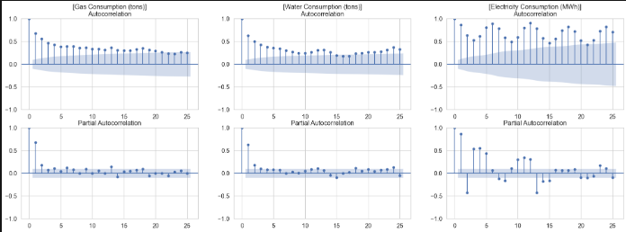
Autocorrelation
Next, I used a ACF and PACF plot to find the orders of the columns before using models such as ARIMA/AR/MA/SARIMA. Through looking how correlated the values are to its lags, I am able to identify the orders.
In the next slide, I will show the orders that I extracted from these graphs.

Slide 17
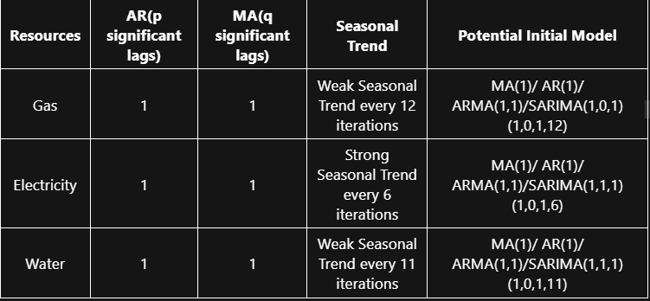
Orders
Note that electricity and water both require differencing.

Slide 18
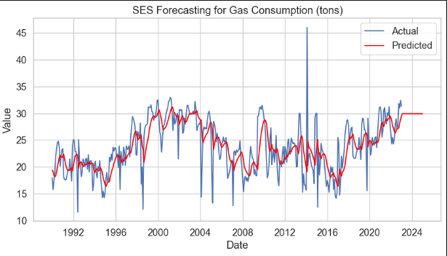
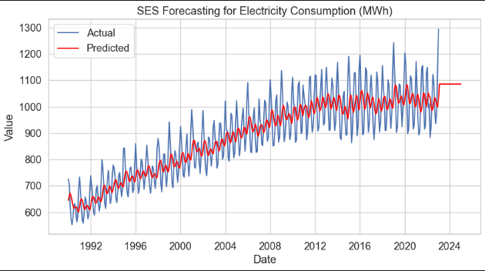
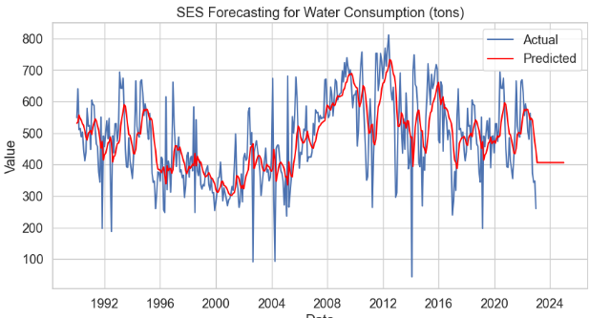
Baseline Model
For my baseline model, I used Simple Exponential Smoothing (SES).SES is a straightforward method that is easy to understand and implement. It is very easy to interpret and handles simple patterns very easily, hence, making it a good starting point.

Slide 19
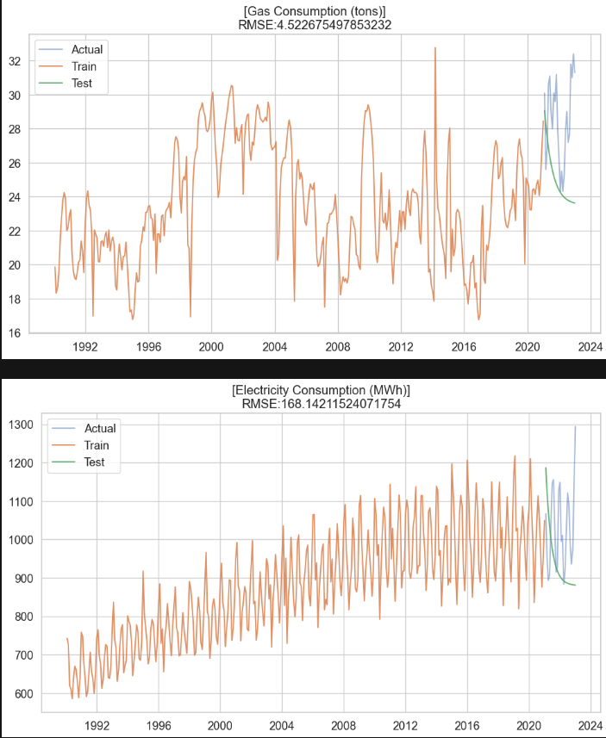
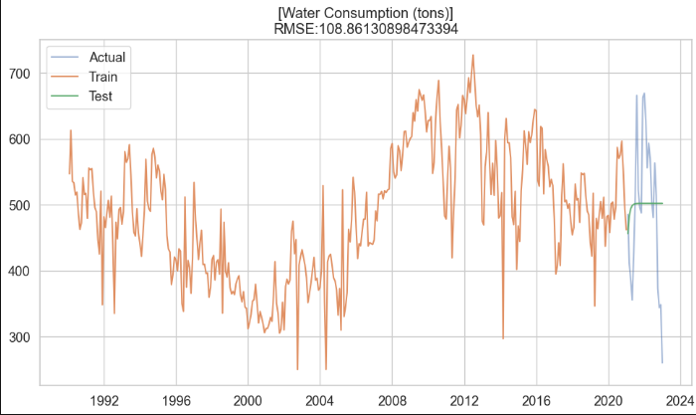
Model Selection
Next, I used ARIMA as my first proper model. ARIMA (Autoregressive Integrated Moving Average), combines auto-regression, differencing, and moving averages to capture and predict patterns in time series data. I used RMSE in order to gauge how good the models are.
As seen in the graph, the predictions are very simple, and looks like it doesn’t recognise any patterns. However, as seen from the results, it doesn’t perform very badly.

Slide 20
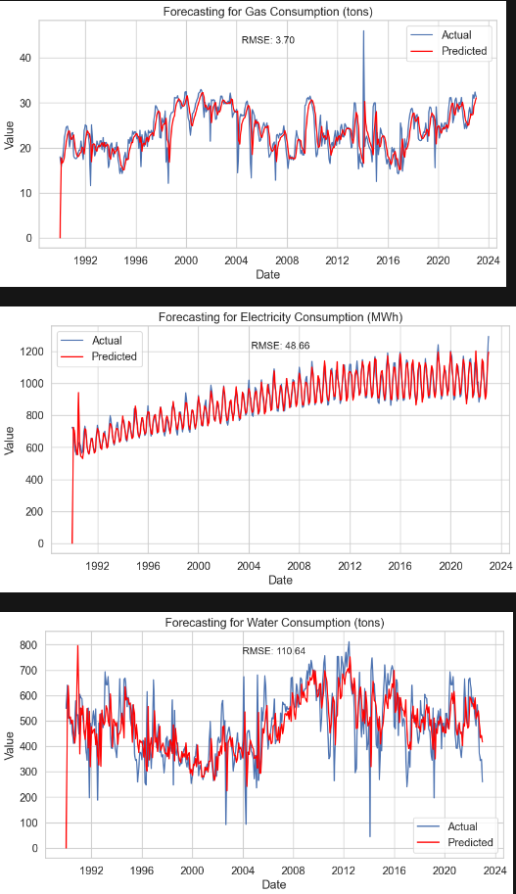
Model Selection
Next, I used SARIMA. Seasonal ARIMA (SARIMA) is an extension of the ARIMA model that incorporates seasonality into time series forecasting.
In addition to the autoregressive (AR), integrated (I), and moving average (MA) components, SARIMA includes seasonal versions of these components to capture recurring patterns in the data over specific time intervals.
It allows for modeling and forecasting data with both long-term trends and repeating seasonal patterns, making it suitable for datasets that exhibit both temporal dependencies and seasonality.
As seen in terms of RMSE, all of the columns show a better result than ARIMA. Hence, I will be picking SARIMA as my final model.

Slide 21
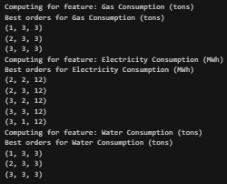
Model Improvement
Next, I tuned the hyperparameters in order to find the best orders for the model, with seasonality. However, some of them cannot be used. This is because the AR and MA orders should not be the same for both the seasonal and non-seasonal components. I resolved it by swapping numbers with 0, according to my research.

Slide 22
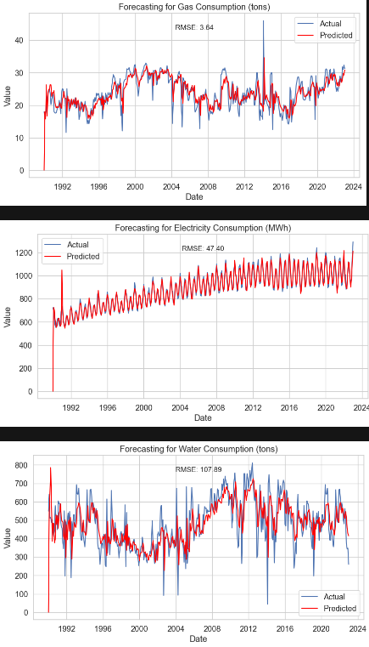
Model Improvement
Finally, I plotted the results of the final model with the most optimal orders. We can see that there is a very slight improvement. Hence, I would pick SARIMA as my model of choice to make predictions on this dataset.

Slide 23
02
Customers Clustering

Slide 24
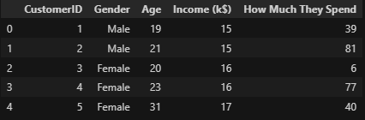
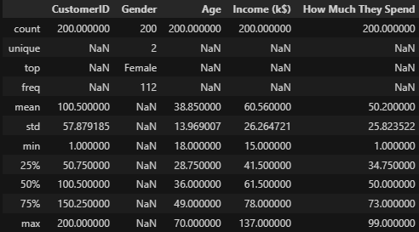
Exploratory Data Analysis
-From the outputs, we can see that there is 1 categorical feature, gender
-The other features are all numerical, and there is 1 unique identifier (CustomerID).
-There are a total of 200 data points and 5 columns.
-All features have more than 1 unique value, which means that all can be used in the analysis.

Slide 25
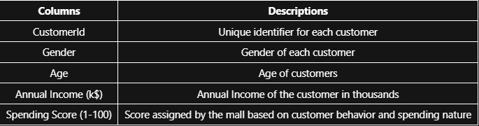
Exploratory Data Analysis
A summary of what I think the columns mean.

Slide 26
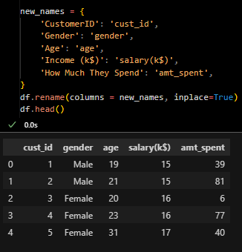
Exploratory Data Analysis
Firstly, I changed column names so that they’re easier to call and avoid any errors in spelling. This also aimed to remove spaces in any of the column names.

Slide 27
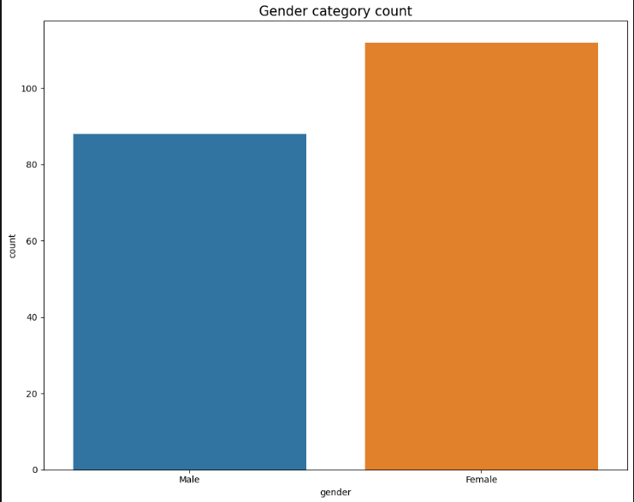
Visualisation
Firstly, I plotted the count of the only categorical feature, which is gender. As seen, there are more female than male customers.

Slide 28
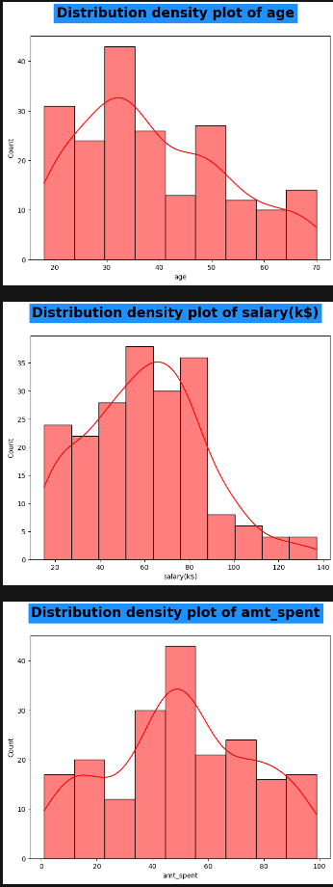
Visualisation
Looking at the distribution, salary and amt_spent are close to normal distribution. On the other hand, age is slightly positively skewed. Most customers earn middle to low salaries and are on the younger side, but there is a variety of amt_spent.

Slide 29
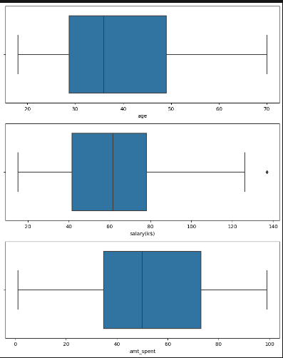
Visualisation
Next, I checked for any outliers and found the visualised the average values of each numerical column. The dataset is very clean and only salary has 1 outlier, which I chose not to drop.

Slide 30
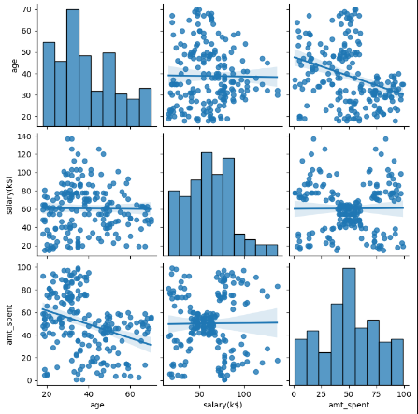
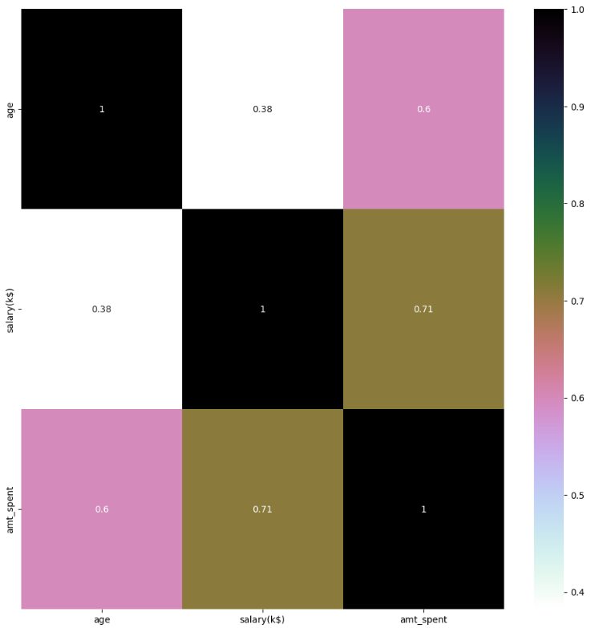
Visualisation
Next, I plotted a pair plot to see if there are any predetermined clusters. Looking at salary and amount spent, there looks to be 5 clusters. However, in all other columns, there are no clusters that can be spot, and most columns have a weak to moderate correlation. I also plotted a correlation plot in terms of phik, which is a coefficient that is better at finding non linear patterns between different columns.

Slide 31
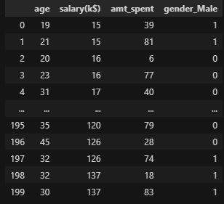
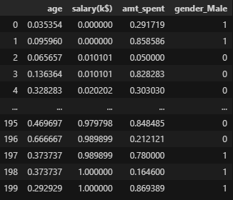
Data Preprocessing
Next, I encoded the categorical values. For gender, as there is no hierarchy, I used get_dummies in order to assign a binary encoding to customers within 1 are male, and 0 to customers who are not male in a column called gender_Male.
Following that, as there are different scales of numerical values, I used quantiletransformer, which transforms the data to follow a uniform or Gaussian distribution and is useful for handling skewed data. This is perfect for the features in this dataset as they are all positively skewed with very little outliers.

Slide 32
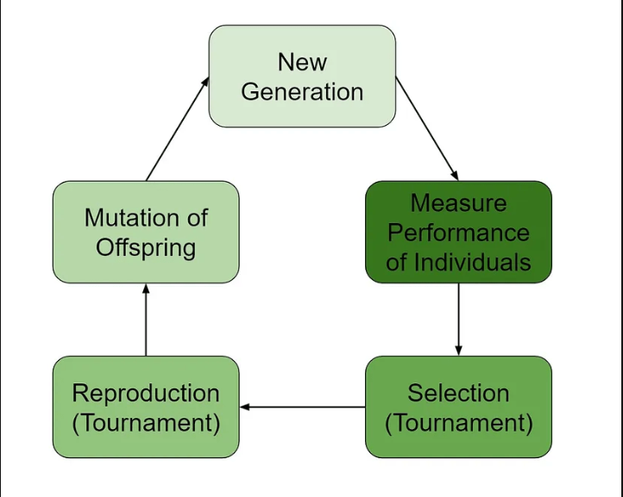
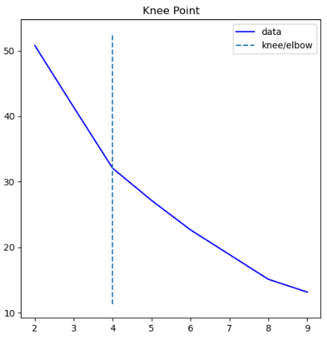
Feature Selection
I used a genetic algorithm to select features. The picture on the left shows how it works. However, before I selected features, I had to find the optimal number of clusters first. Using a package called kneed, I didnt eyeball the elbow point as it wasnt very clear. From the graph, the elbow point is 4.

Slide 33
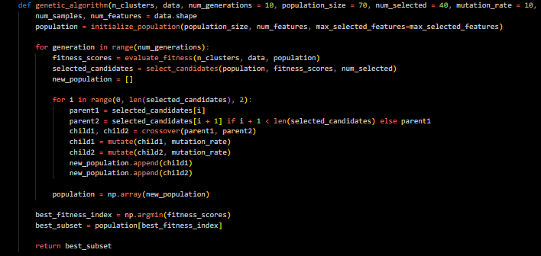
Feature Selection
Using genetic algorithm, I selected the features. It rejected age, which I feel is counter productive due to the context of the analysis. I feel that it is important to the analysis, which made me keep the column first. As the algorithm might not see this and only look at it from an effectiveness stand point, I will still take age as a feature due to its contextual importance.

Slide 34
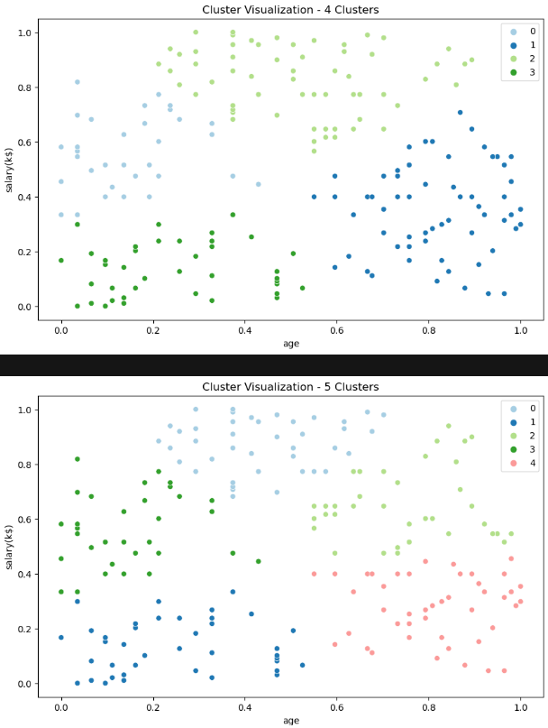
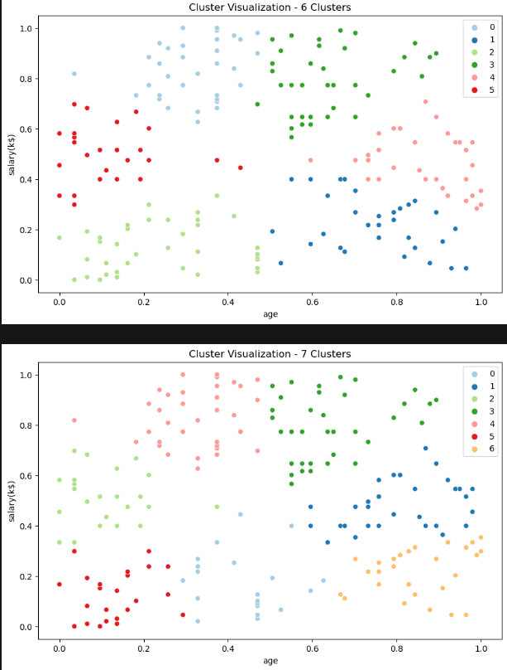
Model Selection
(K-Means)

Slide 35
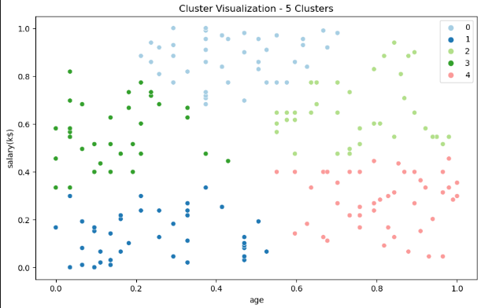
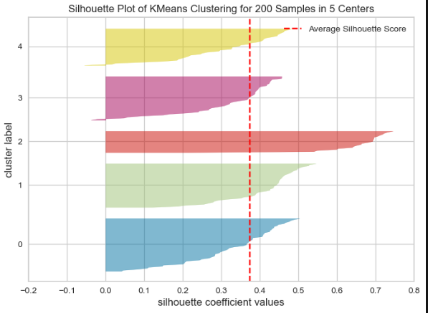
Model Selection
Even though I plotted for many clusters, I feel that 5 is the perfect amount. This is because I feel that it overfits the least as well as captures the data well enough to avoid as much overlapping as possible. Using 5 clusters, we can also see that it has an average silhouette score of above 0.37.

Slide 36
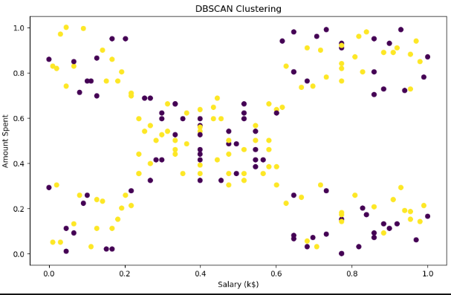
Model Selection
Next, I tried DBSCAN, which was a waste of time as I realised it detected all the points as white noise. This is also the reason why it looks like a child’s drawing; it didnt recognise any patterns or clusters within the data points. Hence, I chose to ignore DBSCAN.

Slide 37
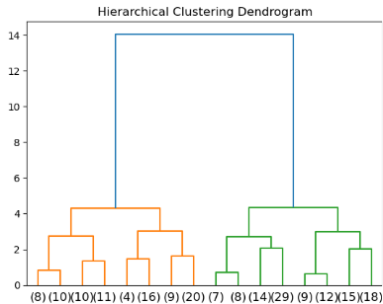
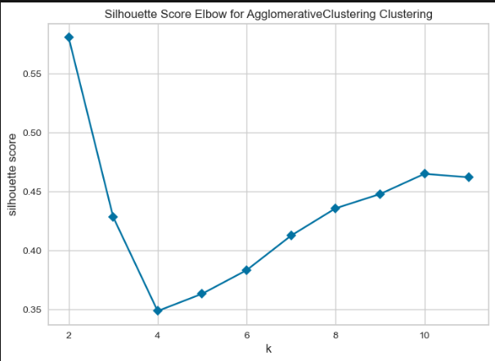
Model Selection
Next, I tried Agglomerative clustering. It ended up with 3 clusters as shown by the 3 distinct colors. As seen by the silhouette score, at 5 clusters, it ended up at about 0.36.

Slide 38
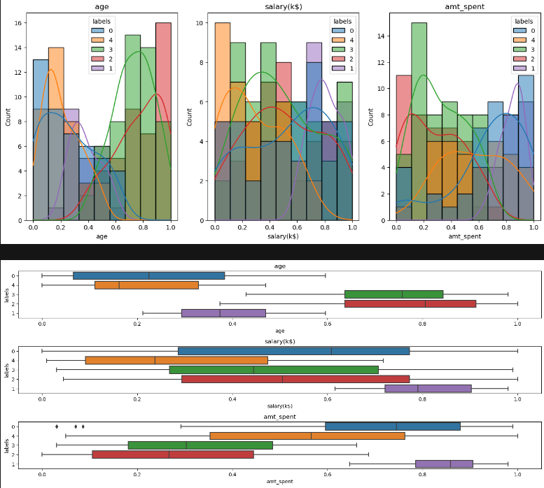
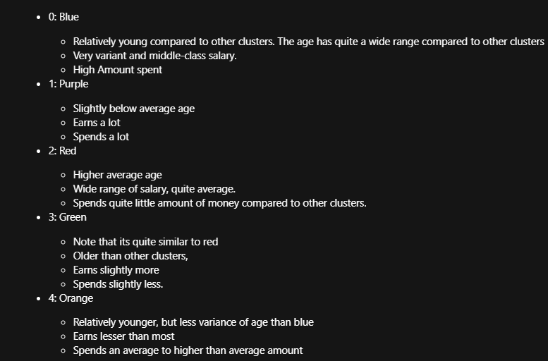
Final model
As KMeans is my final model, I visualised the different statistics of different columns at 5 clusters.
This will help me to identify and label every cluster, helping to see which cluster should have the most priority. Below are the statistics summarised.

Slide 39
Conclusion
In the end, I think we should focus on the stingy buyers.In essence, the "Stingy Buyers" cluster represents an untapped opportunity for businesses to optimize their strategies, enhance customer experience, and drive growth. By understanding and addressing the unique needs of this segment, businesses can improve their overall performance and profitability.

Slide 40
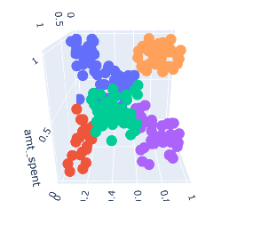
Final Comments
Finally, as there are 3 dimensions to the analysis, I decided to do a 3d plot. As you can see, there is not much overlapping and every cluster is not too wide to the point of overlapping.

Slide 41
Thank you!

